Slide 1
Validation using XML

Slide 2
Methods of Validation
Struts 2 validation is configured via XML OR
Manual validation in the action is also possible, and may be combined with XML.

Slide 3
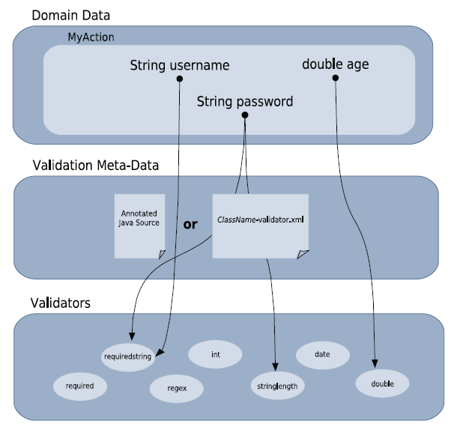

Slide 4
Validation Interceptor
sequence of interceptors from the defaultStack, as defined in struts-default.xml:
<interceptor-ref name="params"/>
<interceptor-ref name="conversionError"/>
<interceptor-ref name="validation"/>
<interceptor-ref name="workflow"/>

Slide 5
Strurs2 Validation
The validation interceptor does the validation itself and creates a list of field-specific errors.
The workflow interceptor checks for the presence of validation errors:
if any are found, it returns the “input” result (by default), taking the user back to the form which contained the validation errors.

Slide 6
If we’re using the default settings and our action does not have an “input” result defined and there are validation (or, incidentally, type conversion) errors, we’ll get an error message back telling us there’s no “input” result defined for the action.

Slide 7
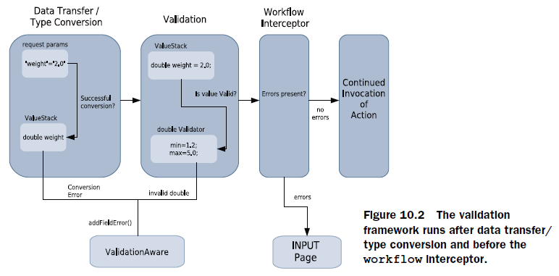

Slide 8
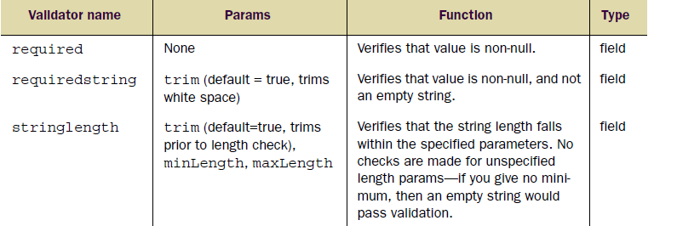
Built-in validators

Slide 9
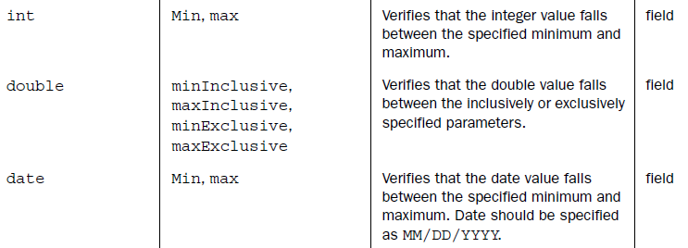

Slide 10
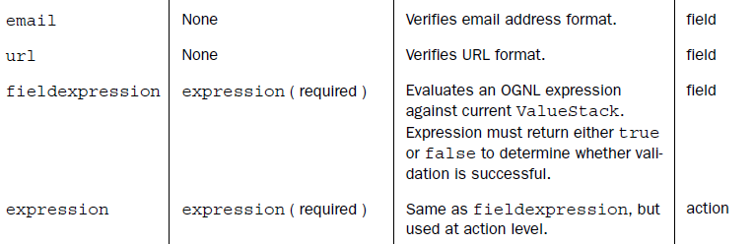

Slide 11
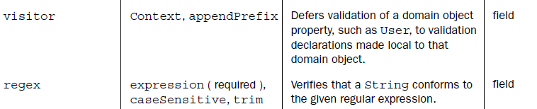

Slide 12
Declaring Validation using XML
For RegisterAction class the validation should be declared in a XML file named as RegisterAction-validation.xml and should be stored in the package as the Action class.

Slide 13
Syntax for declaring validation
Include the DTD definition:
<!DOCTYPE html PUBLIC "-//W3C//DTD HTML 4.01 Transitional//EN" "http://www.w3.org/TR/html4/loose.dtd">
<validators>
<field name="password">
<field-validator type="requiredstring">
<message>You must enter a value for password.</message>
</field-validator>
</field>
</validators>

Slide 14
Dynamic message
<field name="username">
<field-validator type="stringlength">
<param name="maxLength">8</param>
<param name="minLength">5</param>
<message>While ${username} is a nice name, a valid username must
be between ${minLength} and ${maxLength} characters long.
</message>
</field-validator>
</field>

Slide 15
Internationalization of message
<field name="portfolioName">
<field-validator type="requiredstring">
<message key="portfolioName.required"/>
</field-validator>
</field>

Slide 16
Action level validation
<validator type="expression">
<param name="expression">username != password</param>
<message>Username and password can't be the same.</message>
</validator>

